Slide 1

Lending Club Machine Learning
La Shanti Jones

Slide 2
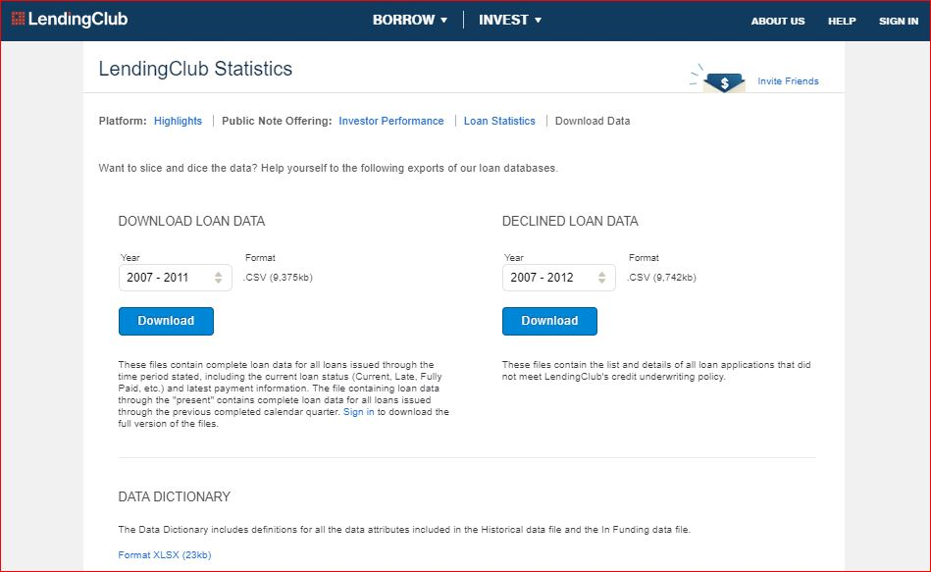

Slide 3
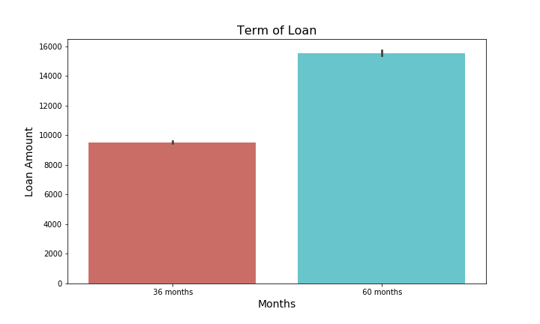

Slide 4
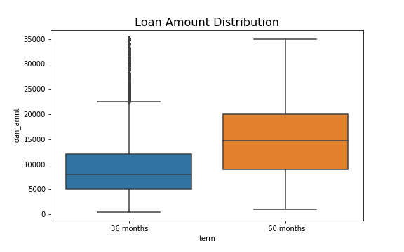

Slide 5
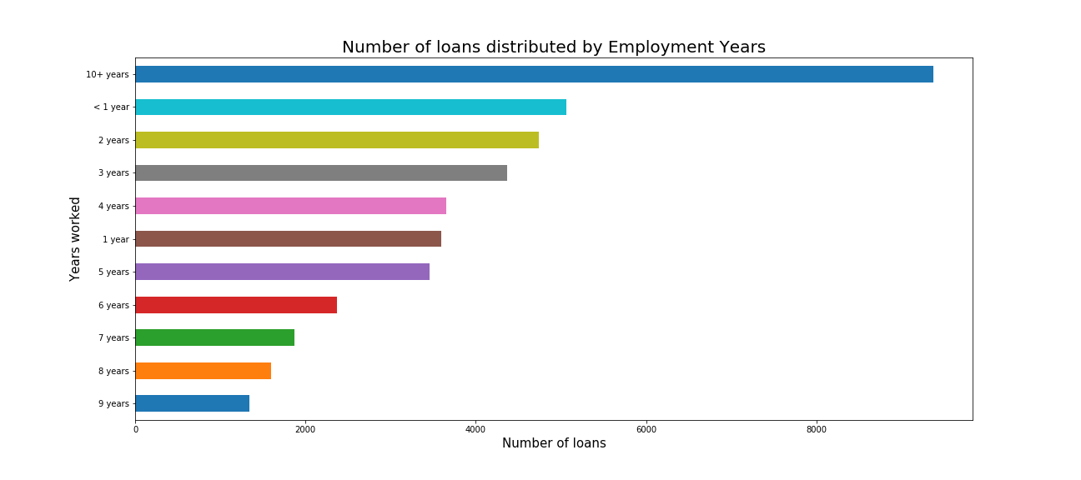

Slide 6
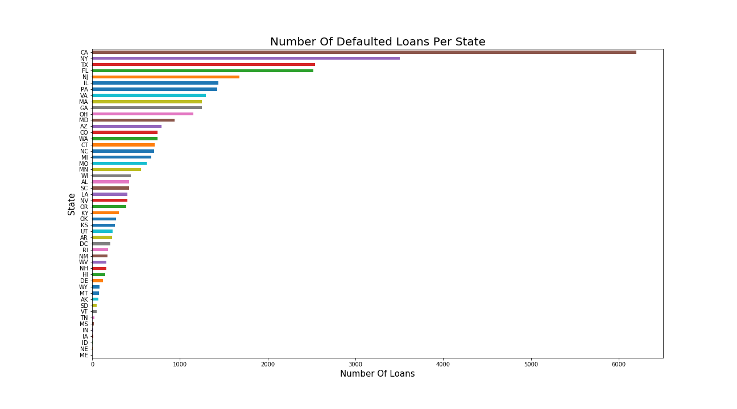

Slide 7
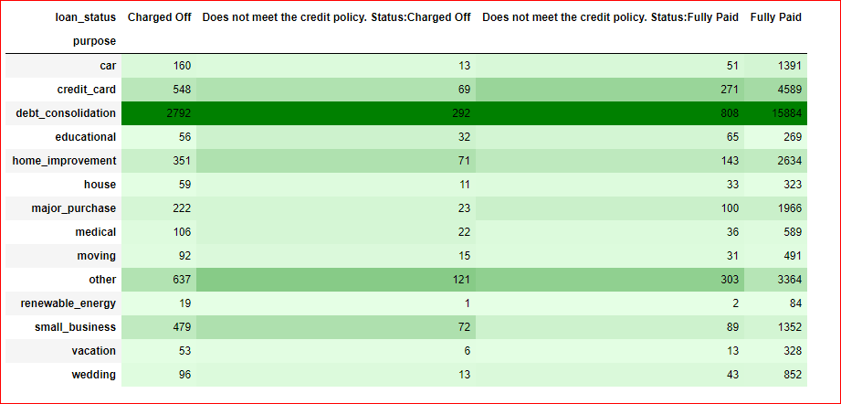

Slide 8
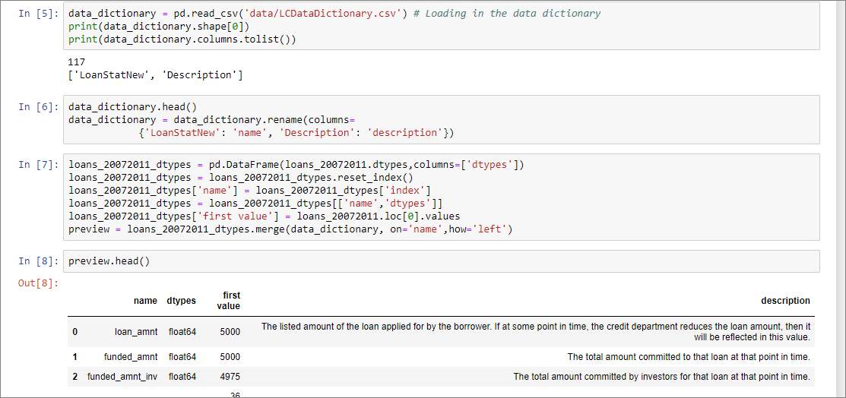
Data cleaning with Pandas
Removing all columns with more than 50% missing values
Removing duplicate rows
Importing Lending Club data dictionary to examine which columns to use for analysis

Slide 9
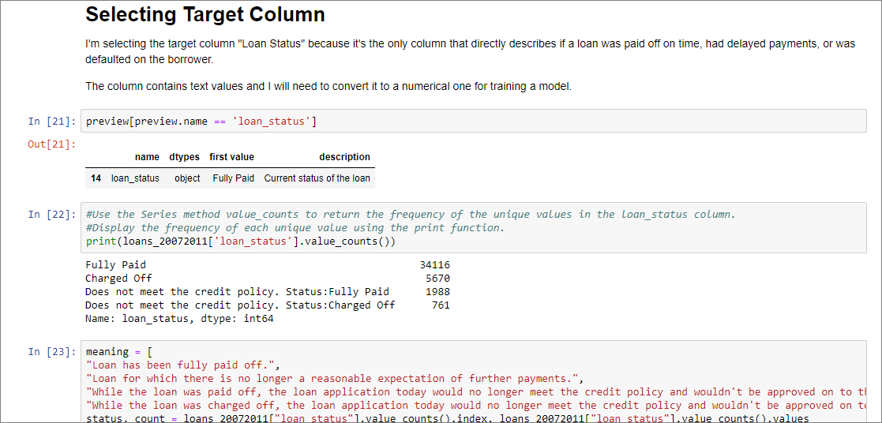
Selecting a Target column

Slide 10
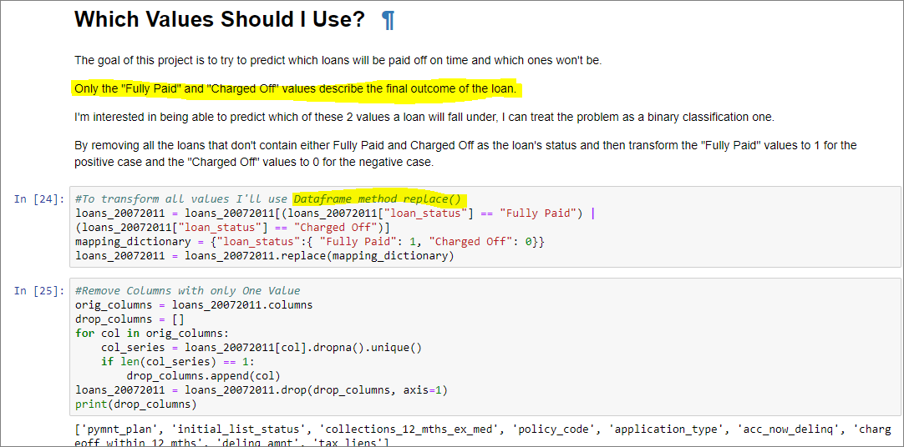
Selecting a Target column

Slide 11
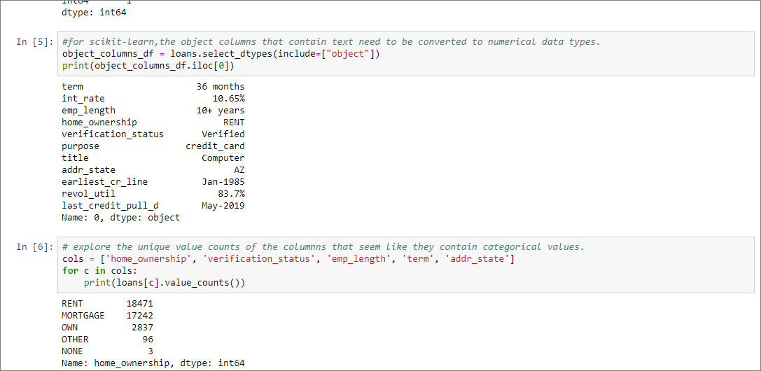
Preparing data for machine learning
1. focusing on handling missing values
2. converting categorical columns to numeric columns
3. removing any other extraneous columns encountered throughout this process.

Slide 12
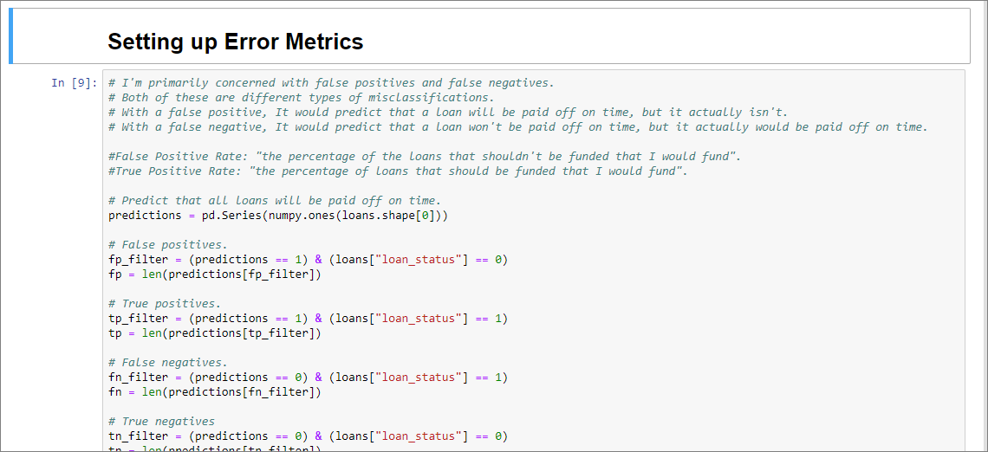
Making Predictions

Slide 13
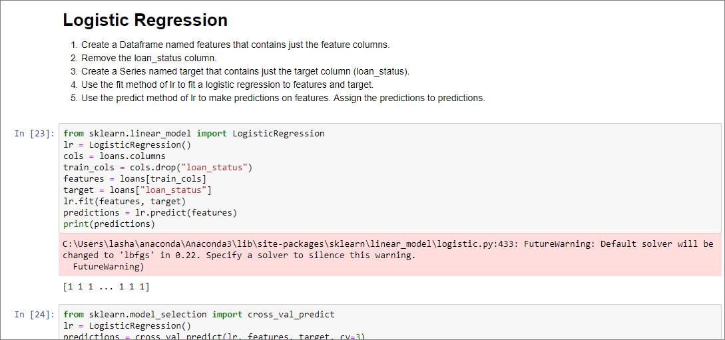

Slide 14
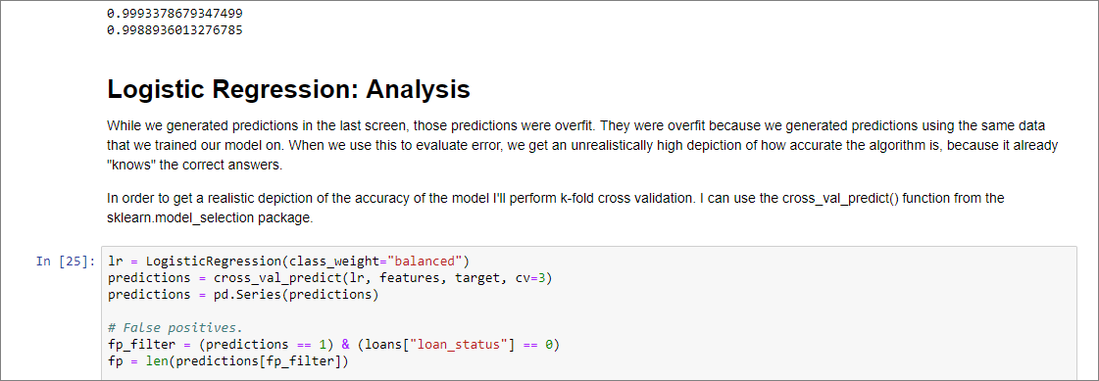

Slide 15
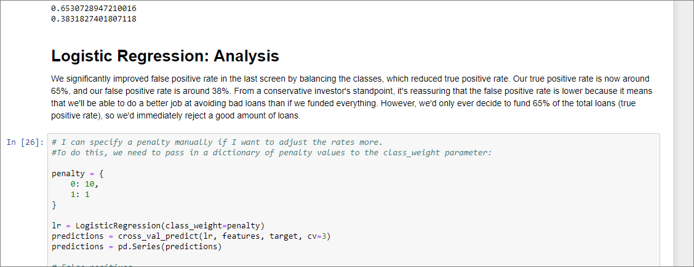

Slide 16
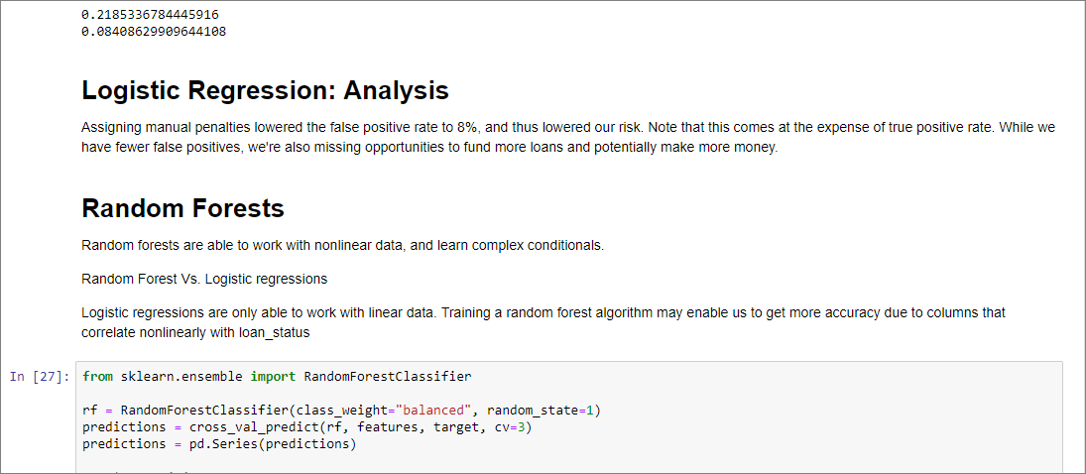

Slide 17
